Slide 1



Year 2
Meet the Team Evening

Slide 2

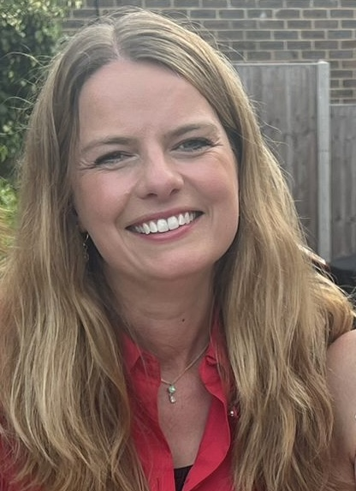
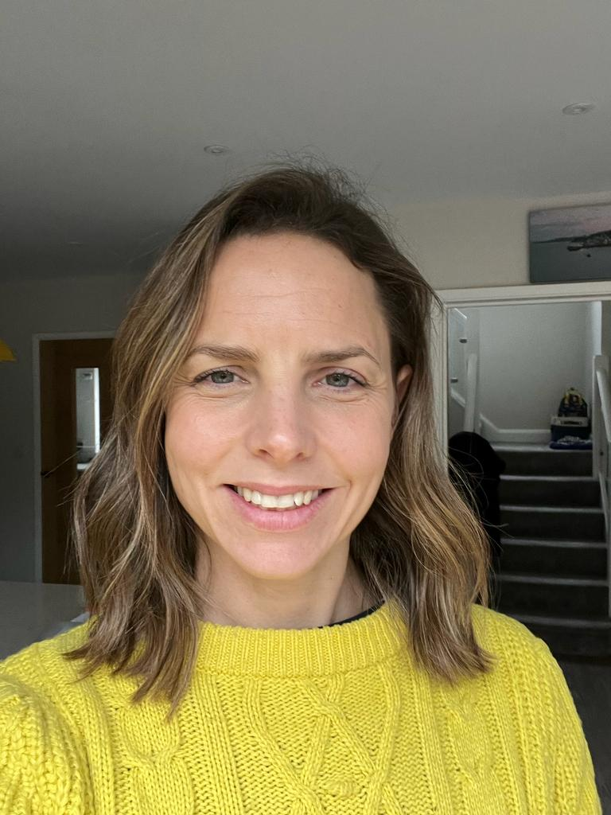
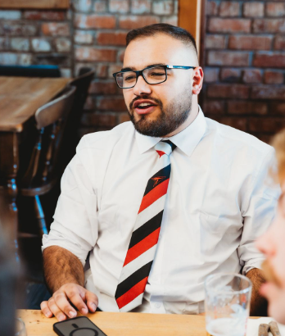
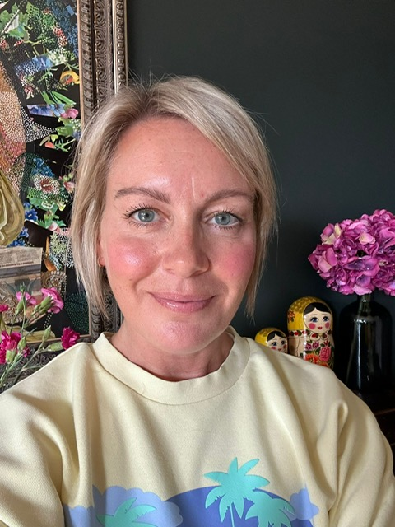
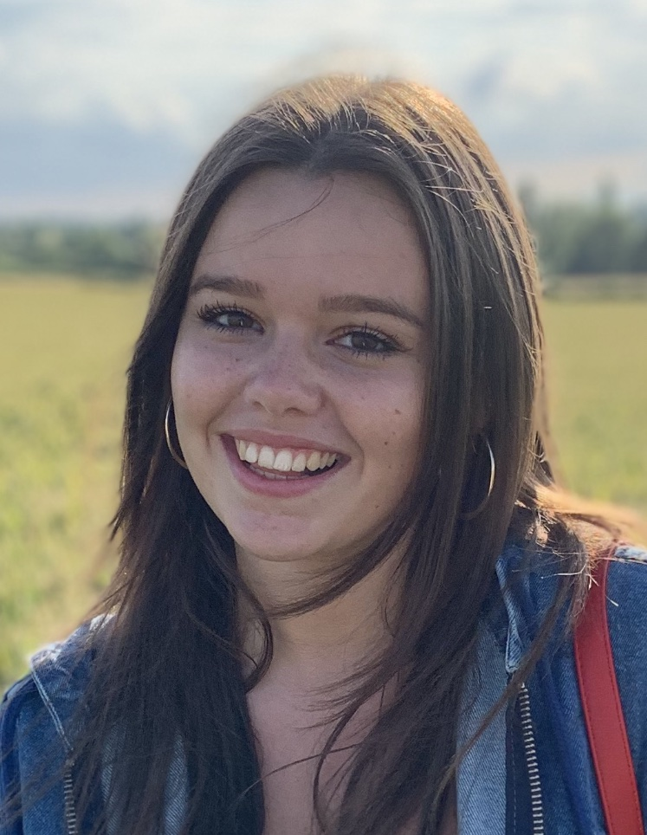
Walnut Class
Eleanor
Toby
Caroline
Chestnut Class
Kim
Jacob
Emma
Notes:
Georgie

Slide 3
ROUTINES
Phonics and Reading
Phonics = Daily – Phase 5 Review (6 weeks) – Bridge to Spelling (6 weeks) – Spelling
Fluency = 3 times per week – groups appropriate to level – regular assessment
Daily
Maths, English and Handwriting (8:30 start)
PE
- PE is on Monday and Wednesday - get changed in school
Kits stay in school - washed in hols - trainers in school
Reading Record
Reading Records in on Thursday with books to be returned.
They will then come home on Friday with a new book. (1 week – 2 week cycle)
Library books on Tuesdays
Notes:
Jo

Slide 4


ENGLISH: READING, WRITING
3 Fluency Sessions per week
LittleWandle system – decoding, prosody and comprehension
Reading for pleasure at home
Reading Record
Phonics/Spelling
Writing
Notes:
Lilja

Slide 5


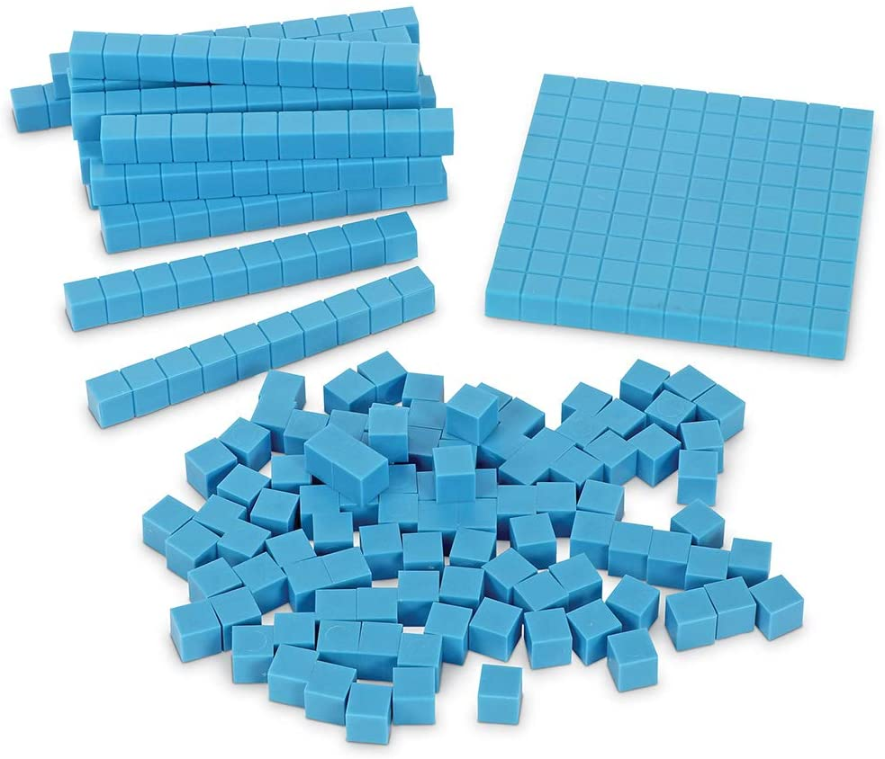


MATHS
Mastery, following White Rose
Use of manipulatives
Support from home – little and often number bonds and then times tables
Numbots – coming soon
TT Rockstars – Introduced when we start multiplication in Spring
Notes:
Jo

Slide 6

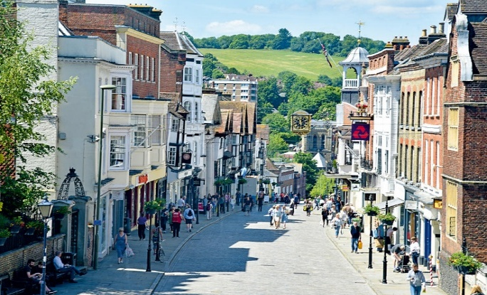




Year 2 Topics
East meets West
World of Inventions
Notes:
Georgie

Slide 7
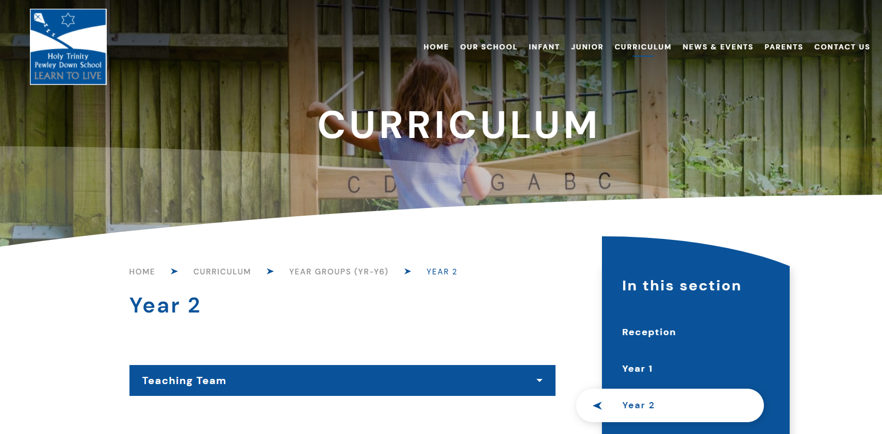

Communication
Reporting absence: infants@htpd.surrey.sch.uk as well as the class teacher
Message books
Weekly JTLYK page
Curriculum
Use of Tapestry
ParentMail
Notes:
Lilja

Slide 8
Trips and Parent helpers
Trips
  St Pauls’ Cathedral – 20th Nov (approx. £25)
  Natural History Museum (Spring term) (approx. £25)
  Guildford Geography Trip (Summer Term) (Free)
  Please do talk to us if you have any difficulties with costs
Outdoor learning…
Notes:
Jo

Slide 9
HTPD Mobile Phone Policy
We have a ‘no mobile phones’ policy and no phones are allowed in class.
No children are currently bringing phones into school in Year 6. If they need to bring a phone parents will need to get permission from Vicky, the head teacher, and the phones are then kept in the office all day. Only feature phones – also known as brick phones or dumb phones – are allowed.
Many local schools now don’t allow mobile phones in school and also insist on feature phones only if absolutely necessary.
E-safety in school and at home

Slide 10

Thank you very much for joining us
Key takeaways:
- Get to know the website
- Please read the JTLYK each week
Contact Us
Toby – tobys@htpd.surrey.sch.uk
Emma – emmaw@htpd.surrey.sch.uk
Notes:
(Lilja to mention hardship fund)

